Slide 1
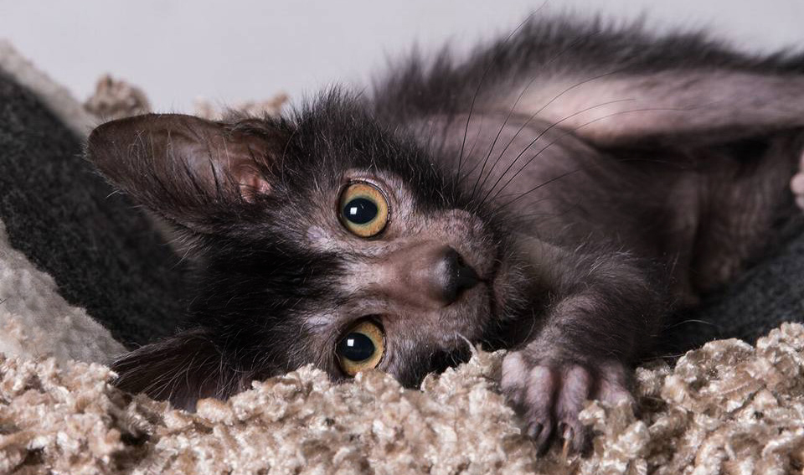
ROCKEFELLER
LYKOI
Breed Overview
Creative Agency Presentation
Photo Credit: Martin Potgieter @sphynx_dobby_lykoi_lobo

Slide 2
Patti Thomas
Dr. Elena Maeva
Massimo Picardello
Founder of Original Lykoi
ME!!!
Seminar moderator.
Background Photo Credit: Martin Potgieter @sphynx_dobby_lykoi_lobo

Slide 3
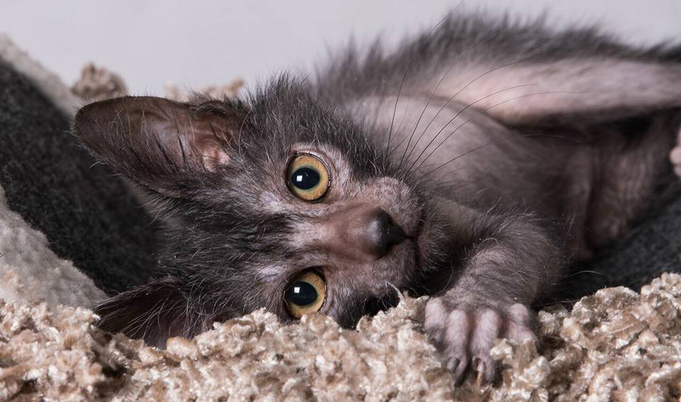
Lykoi History
Research
By Lyons
Standard &
Personality
Lykoi Today
Timeline
1st Mutations
Breed Foundation
Registry Acceptance
Breeder/Cat Count
Clinical & Histological Research
Gene Identification
Scoring
Standard Examples
Roaning & Molting
Colors
Personality
Registry Acceptance
Showing Lykoi
Breeder/Cat Count
Advancement Goals
In the Media
Background Photo Credit: Martin Potgieter @sphynx_dobby_lykoi_lobo

Slide 4
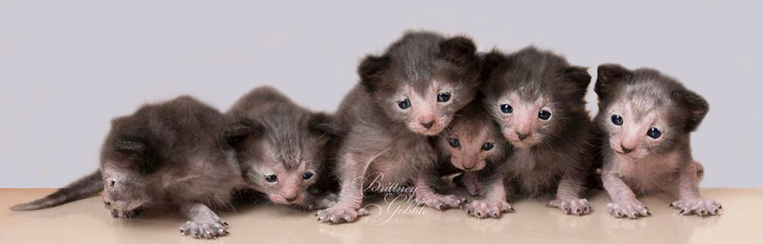
Breed History
Photo Credit: Brittney Gobble, Lykoicats.com

Slide 5
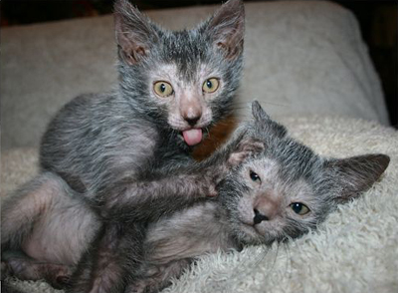
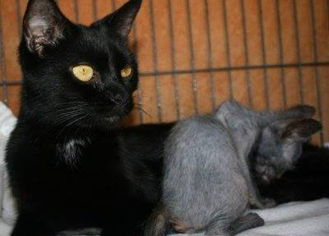
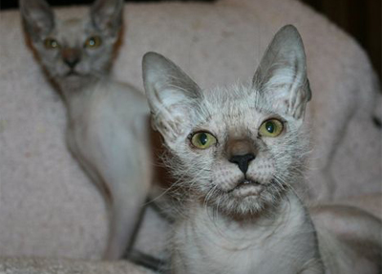
1st Mutations
Original Mother of Mutants:
Eve Havah
Woflie Silver Lining (Male)
Ray of Home (Female)
Born July 4, 2010
PattiThomas
PattiThomas
Given to Patti Thomas, a Sphynx breeder, on September 4, 2010 due to concern about unusual coat.
PattiThomas
DNA tests confirmed coat was not a result of Devon Rex allele (re) and the Sphynx (hr) gene encoding on Keratin 71 (KRT71)
Vet exams & tests confirmed there was no dermatology issue.
Photos Credit: Patti Thomas, Katitudz Lykoi
Background Photo Credit: Brittney Gobble, Lykoicats.com

Slide 6
Breed History
“Lykoi”, which in Greek, roughly translates to “wolf”, is a breed derived from a naturally occurring mutation found in the feral cat population.
The breed was named in 2010 by Patti Thomas, who found the 1st documented mutations in Virginia, USA.
Genetic and health testing was done on the mutations to ensure no disease or disorder was the cause of hair loss.
This included tests for infectious diseases, Sphynx/Devon genes, DNA test for genetic diseases, color and blood type as well as skin biopsies and echocardiograms. They were found to be healthy and the hair pattern was not from any disease or disorder.
Background Photo Credit: Brittney Gobble, Lykoicats.com

Slide 7
Breed History
The first intentionally bred litter of “Lykoi” was done in 2011 between the natural mutations found in Virginia and an additional pair found in Tennessee, USA.
It was determined that the “Lykoi” was indeed a natural mutation.
Through further breedings, it was determined that the “Lykoi” was a recessive trait.
Background Photo Credit: Brittney Gobble, Lykoicats.com

Slide 8
Breed History
2010
2013
2015
The original 2 mutant kittens and mother presented by local VA rescue to Patti Thomas, a Sphynx breeder. Mutation named “Lykoi” by Patti Thomas.
2011
Lykoi gain Preliminary New Breed Status in TICA. 15 breeders around the world are established.
.
2014
Over 200 LY and LY carriers registered in TICA.
South African Cat Club, governed by WCF, announced the Worlds First Lykoi Champion.
2017
2 semi-hairless cats found in TN. Both pairs bred. First intentionally bred Lykoi litter was born.
Leslie Lyons starts Lykoi research projects: Lykoi Genetic Marker & Histology of Coat & Skin.
Lykoi gains Championship status in TICA. Application for Misc Status in CFA submitted.
Background Photo Credit: Brittney Gobble, Lykoicats.com

Slide 9
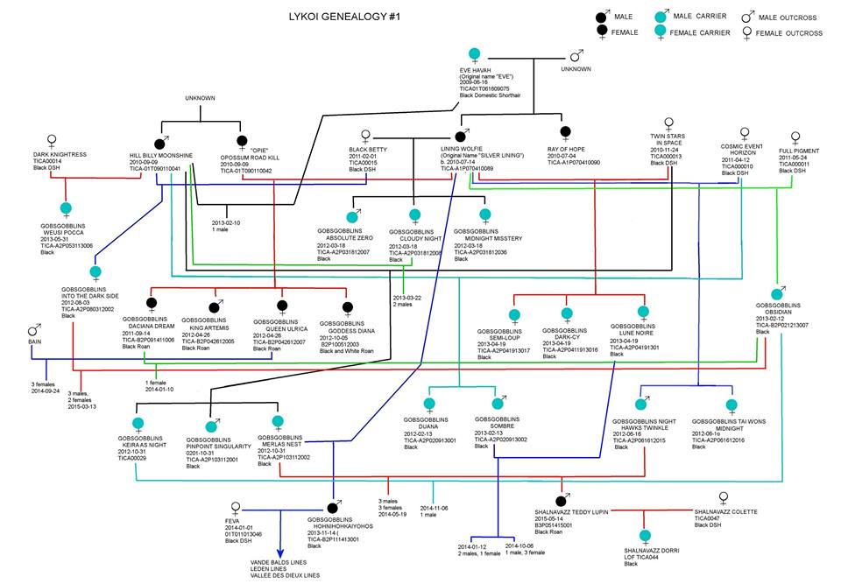
Breed Foundation
1st – 3rd Generations
Vet exams & tests confirmed there was no dermatology issue.
Pedigree Credit: Sarah Hartwell, messybeast.com
Background Photo Credit: Brittney Gobble, Lykoicats.com

Slide 10
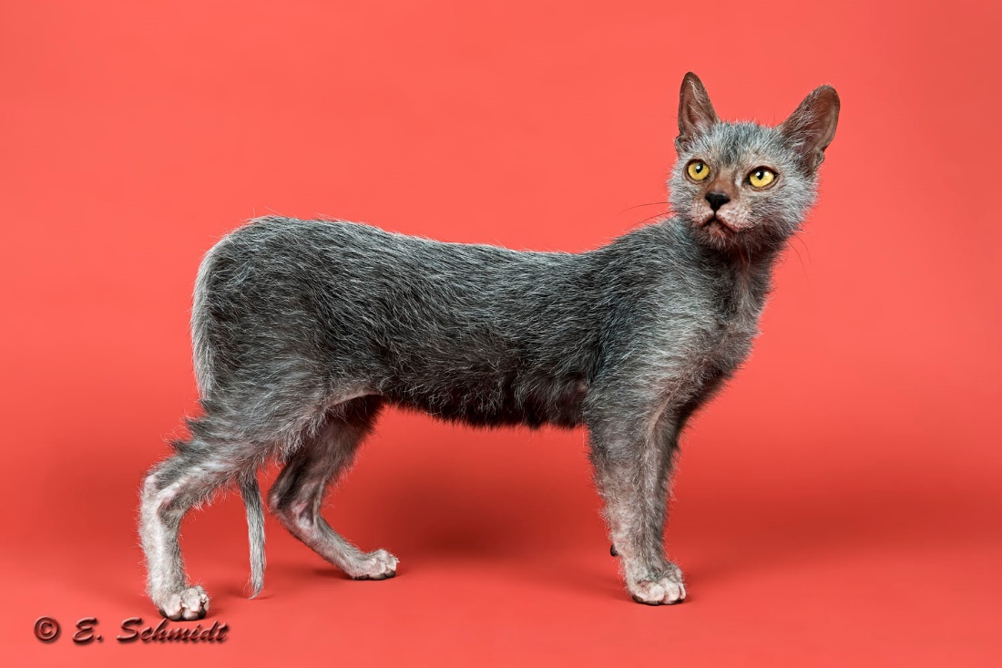
Breed Research

Slide 11
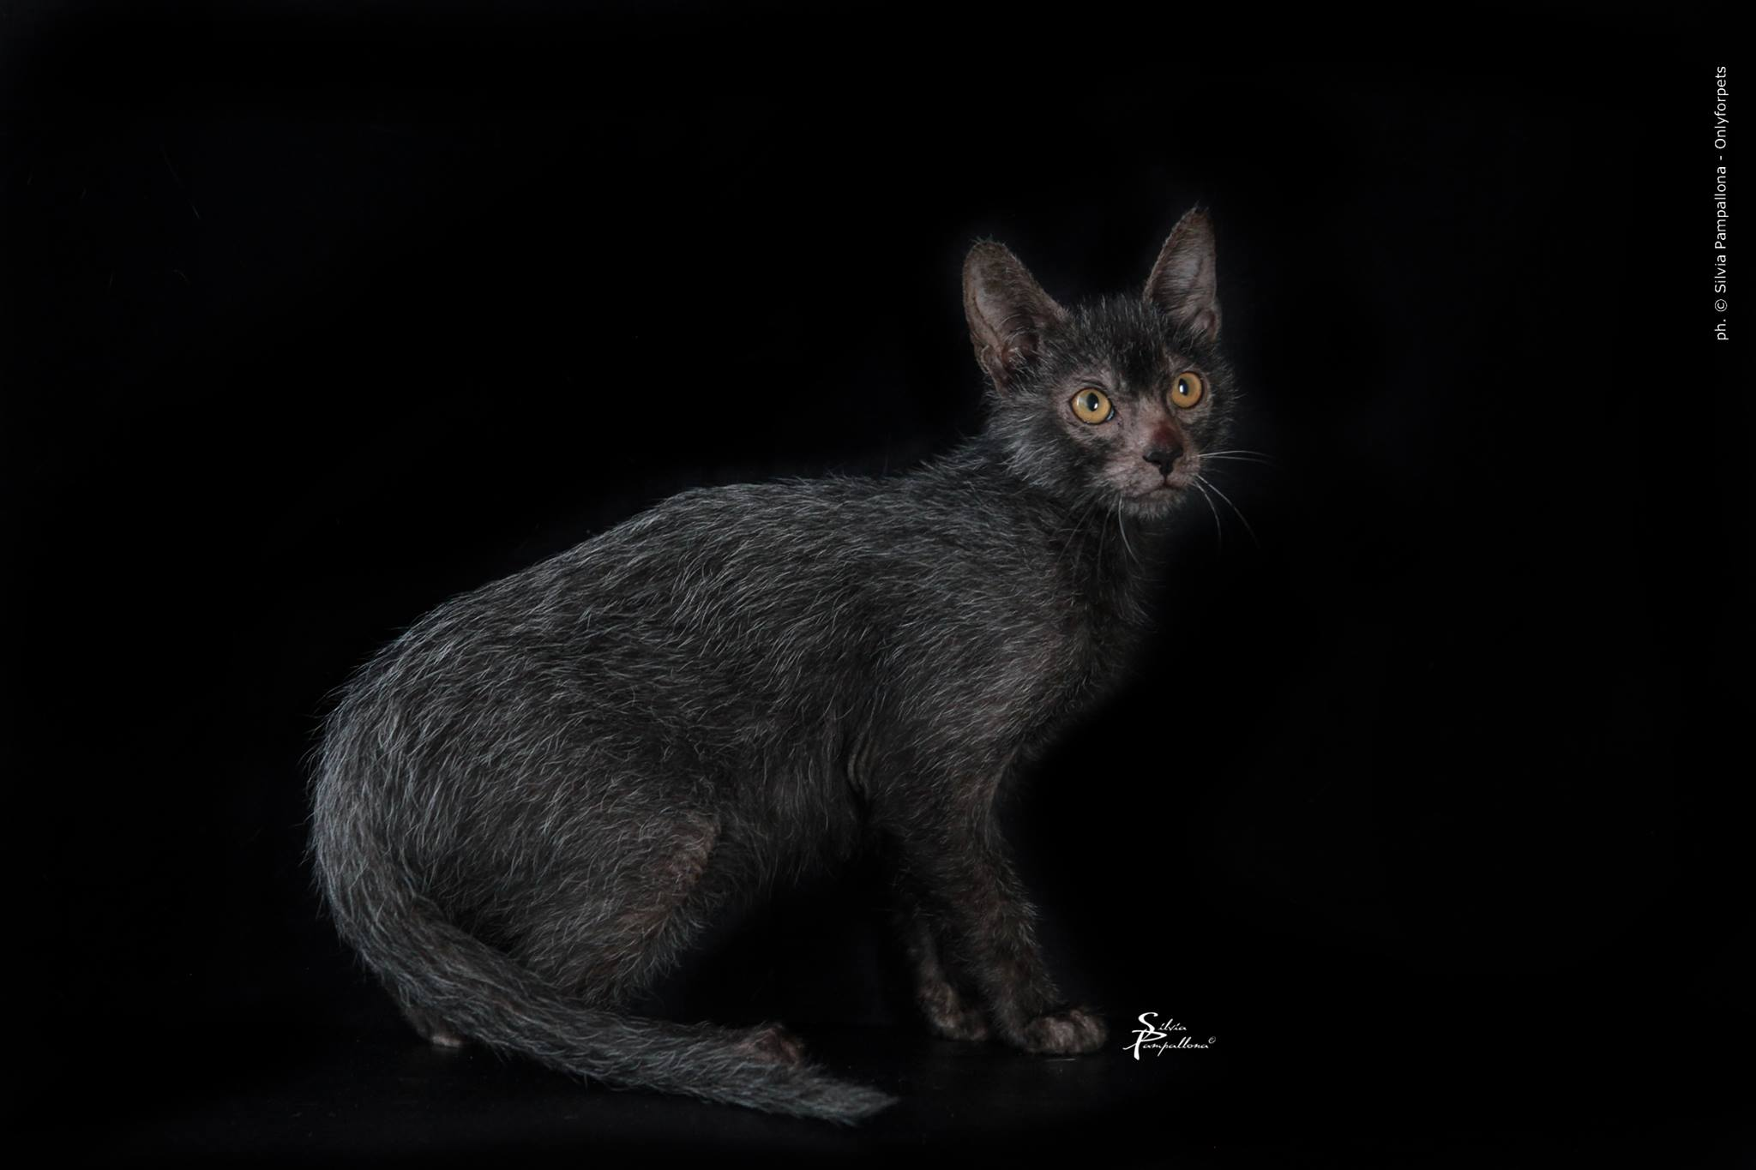
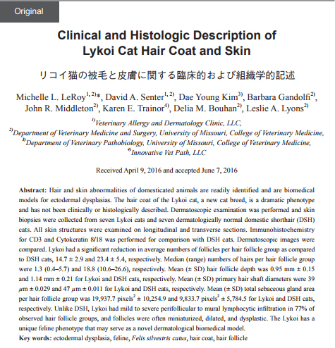
Scientific Research On The Lykoi Cat
Clinical and Histological Description of Lykoi Cat Hair and Skin
by Dr. Leslie Lyons, Feline & Comparative Genetics, University of Missouri
The dramatic hair coat phenotype of the Lykoi cat was researched at the University of Missouri by Dr. Leslie Lyons and her team in 2016. Their goals were to:
Provide a clinical and histological description of the Lykoi cat skin, hair follicle, hair shaft, hair follicle density, and pilosebaceous components
Examine Lykoi cat skin dermatoscopically
Compare Lykoi histological finding to domestic shorthair (DSH) cats.
Determine how the new traits of interest affect that cat’s health
Determine if the novel traits discovered could support new breed development
Determine if the novel traits discovered could be used as biological models.
Lykoi Hair and Skin Components Studied:
Hair Coat
Skin
Vibrissae
Claws
Teeth
Hair Shafts
Hair Follicle Density
Pilosebaceous Components
Background Photo Credit: Brittney Gobble, Lykoicats.com

Slide 12
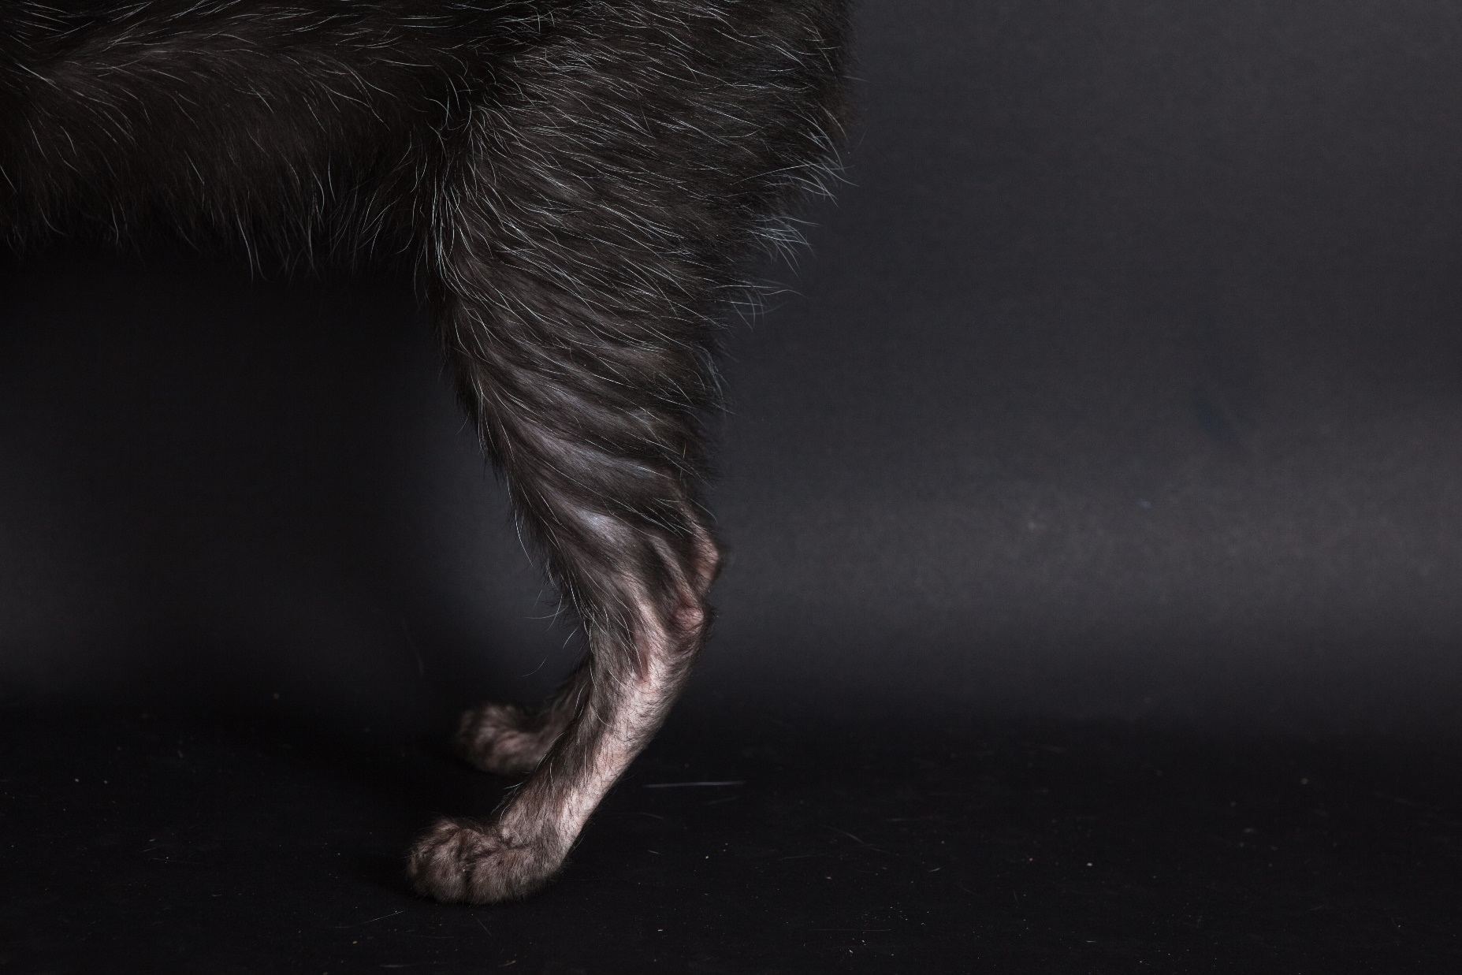
Scientific Reseach On The Lykoi Cat
Principle Findings:
Lykoi hair follicles are developed in a way which prevent the undercoat from being maintained in the same manner as other cats. Consequently, they molt and can go completely bald some of the time, only to re-grow a new coat.
#1 - Lykoi have fewer hair follicles than a normal coated cat.
#2 - Lykoi have fewer in a hair follicle unit than normal coated cat.
#3 - Secondary hair follicles were fewer in number in Lykoi cats.
#4 - There is a higher number of Lymphocytes (white blood cells/immunity) in the hair follicles of Lykoi cats.
NOTE: The gene has been located for the Lykoi coats and details will be published in 2018 and tests made available to the public.
Background Photo Credit: Brittney Gobble, Lykoicats.com

Slide 13
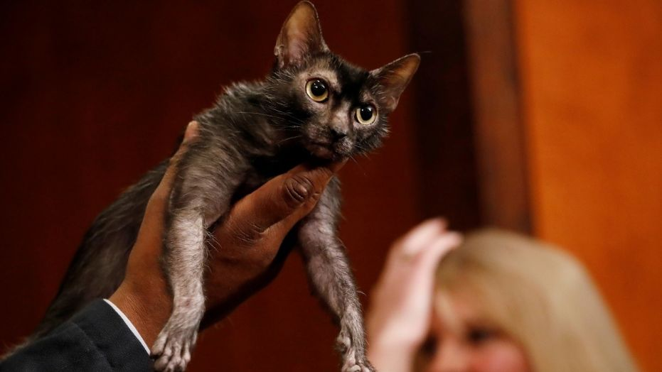
Breed Standard
Photo Credit: foxnews.com (Reuters)

Slide 14
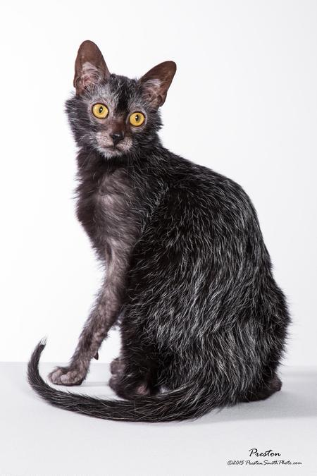
Breed Standard
The Lykoi is a partially hairless breed of cat with a coat that is unique to them.
A combination of distinct traits set the Lykoi apart from all other breeds:
1) Roaning; an amelanistic color pattern of intermixed white and colored guard hairs. The pattern is found in other animals, such as horses, but has not been noted in any other breed of cat.
2) A lack of undercoat.
3) Sparse hair on legs, feet and face mask which gives the appearance of a werewolf.
The large, bright, walnut shaped eyes combined with these distinct traits, give the “Lykoi” a werewolf-like appearance.
Photo Credit: Preston Smith
Background Photo Credit: foxnews.com (Reuters)

Slide 15
Breed Standard
Category: Traditional black only.
Allowable outcross breeds: BLACK Domestic shorthair
Breed Notes: Due to the limited gene pool, any cat naturally born to have the sparse hairless and intermixed amelanistic (roan) hair, regardless of show standard, may be registered for breeding and show if approved by three TICA AB Judges.
They can be used in showing if they meet the standard.
Total 35
8
8
8
8
2
1
Total 25
6
6
5
5
3
Total 40
12
12
4
12
HEAD
Muzzle/Chin/Nose
Shape
Ears
Eyes
Profile
Neck
BODY
Torso
Musculature
Legs
Boning
Tail
COAT
Texture/Density
Color/Roaning
Length
Mask
Background Photo Credit: foxnews.com (Reuters)

Slide 16
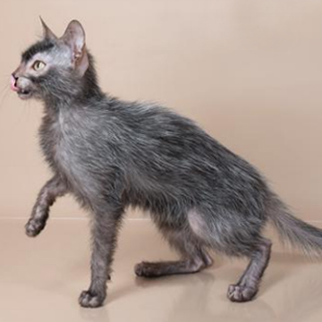
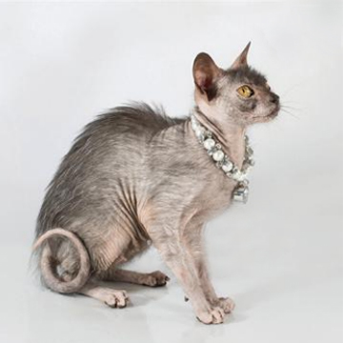
Coat - 40 Points
Proper Coat
Coat is too sparse.
The accepted range of colored hair percentage is 30 to 70%, with 50% being ideal. Hairless Mask present and coat is neither too full or too sparse.
Photos Credit: Brittney Gobble, Lykoicats.com
Background Photo Credit: foxnews.com (Reuters)

Slide 17
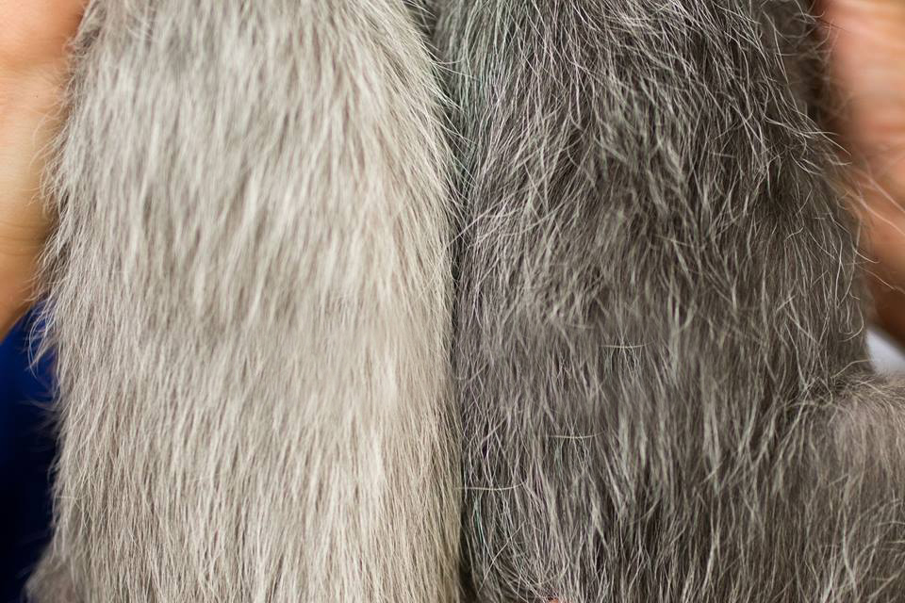
Roaning Variation
ROANING: A unique coloration in which solid white hairs are thickly interspersed with normal pigmented hair through a cats coat.
The amount of roaning on a cat can very depending on cat, color and phase in molt cycle. The accepted range of colored hair percentage is 30 to 70%, with 50% being ideal.
Roaning in Blue Coat vs Roaning in Black Coat
Background Photo Credit: foxnews.com (Reuters)
Photo Credit: Brittney Gobble, Lykoicats.com

Slide 18
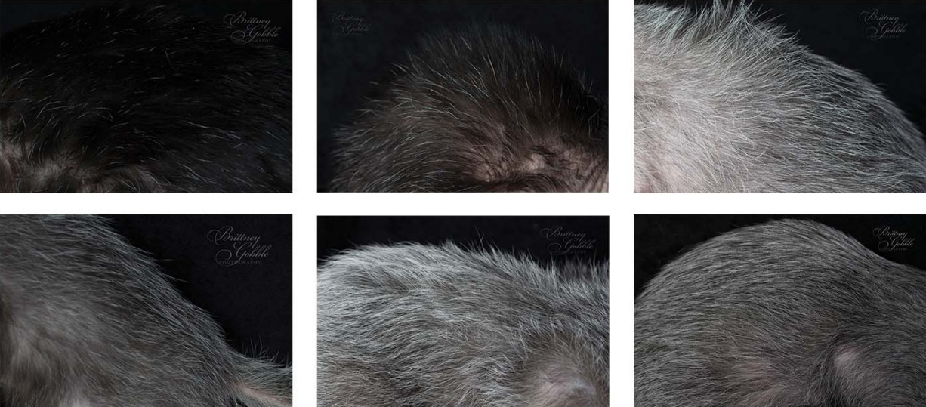
Roaning Variation
The white hairs of roaning, will comprise 30-70% of the coat on a black cat.
Background Photo Credit: foxnews.com (Reuters)
Photo Credit: Brittney Gobble, Lykoicats.com

Slide 19
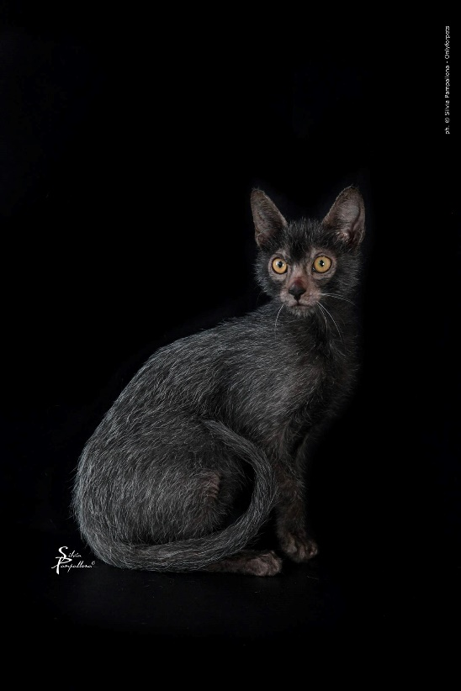
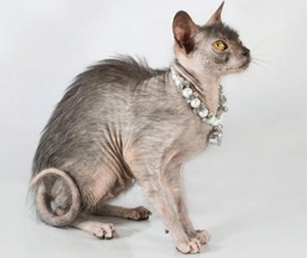
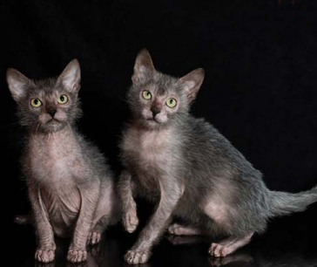
Molting Coat
In-Molt Coat
Typical Coat
PERFECT Coat
Lykoi rarely keep the same coat all year. There are different stages based on hormones, weather, etc. The coat also depends on the bloodlines and the individual cat. However, some Lykoi do tend to keep the same coat all year long.
Due to the nature of the gene, Lykoi are unable to grow a full undercoat at any time. They do shed, and while some families with allergies have no issue with the breed, Lykoi are not hypoallergenic.
Background Photo Credit: foxnews.com (Reuters)
Photos Credit: Brittney Gobble, Lykoicats.com, Silvia

Slide 20
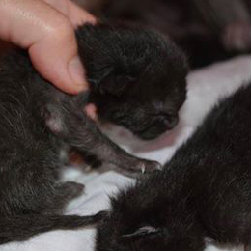
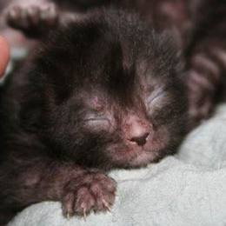
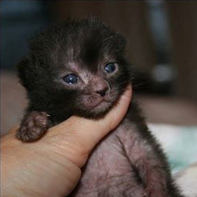
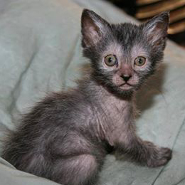
The 1st Molt
Day 1
Day 3
Day 10
4 Weeks
Background Photo Credit: foxnews.com (Reuters)
Photo Credit: Patti Thomas, Katitudz Lykoi

Slide 21
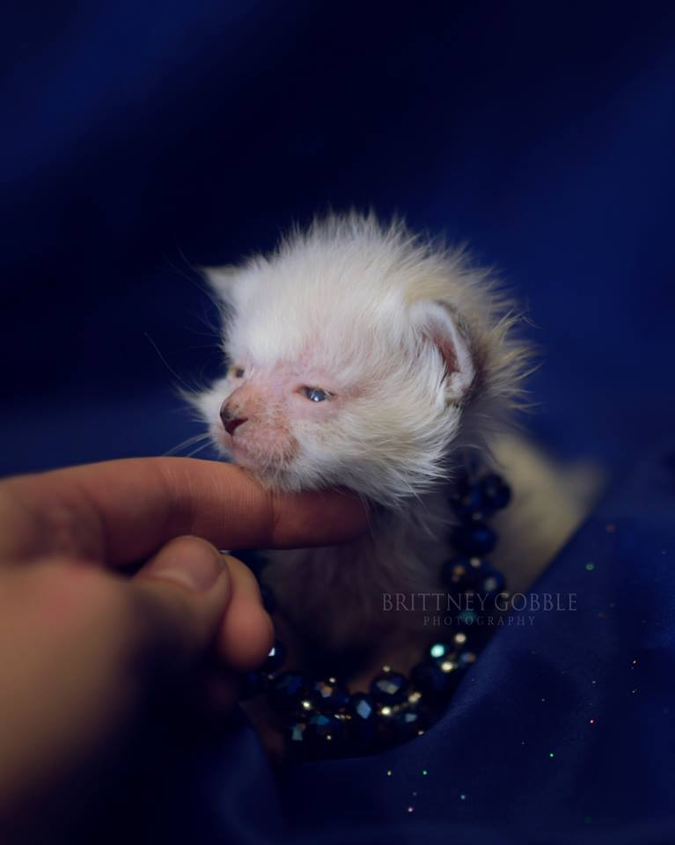
Breed Colors
Solid Colors
Lykoi cat foundations may appear in all coat colors. But only Black is permissible, the reason for it is the striking look of roan pattern on blsck, that misses the point on any other less contrast color.
Blue Point
Background Photo Credit: foxnews.com (Reuters)
Photo Credit: Brittney Gobble, Lykoicats.com

Slide 22
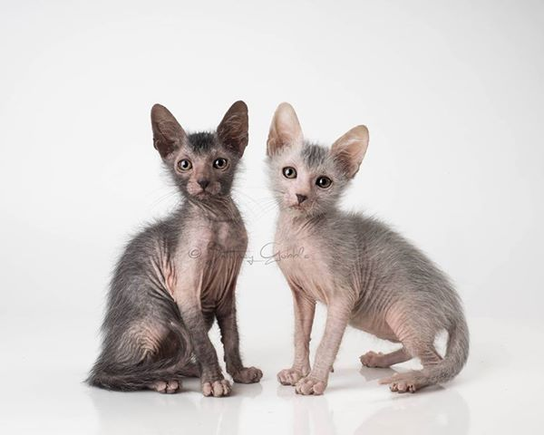
Breed Colors
Solid Colors
Black / Blue
Background Photo Credit: foxnews.com (Reuters)
Photo Credit: Brittney Gobble, Lykoicats.com

Slide 23
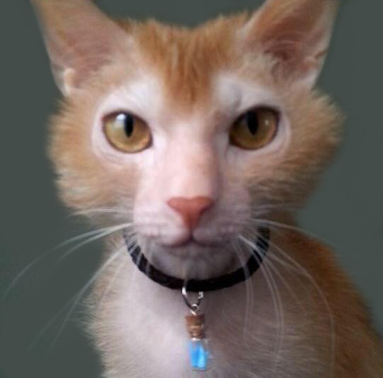
Breed Colors
Solid Colors
Red
Background Photo Credit: foxnews.com (Reuters)
Photo Credit: Lauren Isabelle

Slide 24
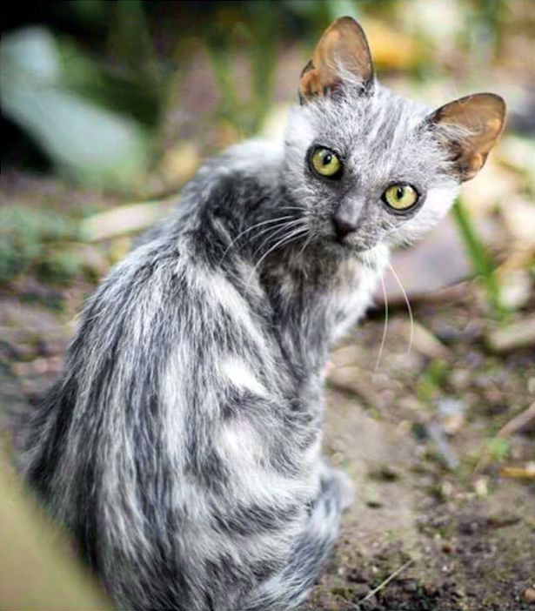
Breed Colors
Tabby
Photo Credit: @theworldsyoungestman

Slide 25
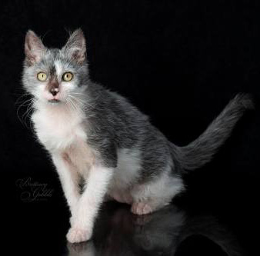
Breed Colors
Black Bi-Color
Photo Credit: Brittney Gobble, Lykoicats.com

Slide 26
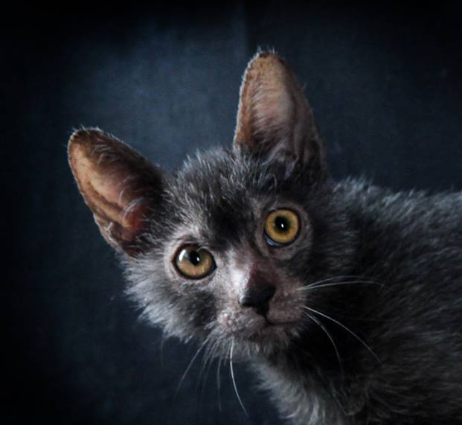
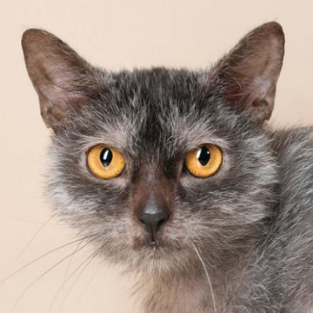
Head Shape - 8 Points
Proper Head
Forehead is flat, head is square and short.
The head is a modified wedge with rounded contours from nose to cheeks to ears. Slightly rounded forehead. Slightly longer than wide.
Photos Credit: Brittney Gobble, Lykoicats.com

Slide 27
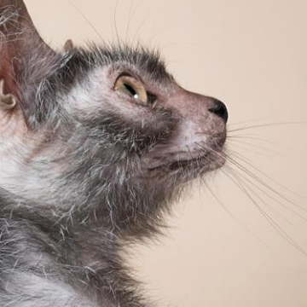
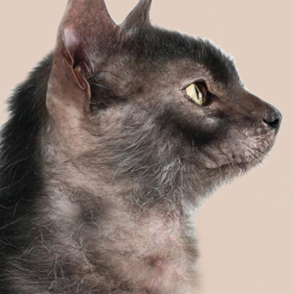
Chin - 8 Points
Well-Developed Chin
Chin is receding.
Muzzle ends with a well-developed chin, aligned vertically with nose; full but neither projecting or receding.
Photos Credit: Brittney Gobble, Lykoicats.com

Slide 28
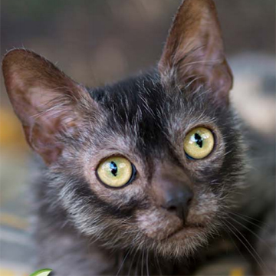
Muzzle - 8 Points
Well-Developed Muzzle
Muzzle is medium in length; fleshy, gently rounded hairless whisker pads with a definite whisker break. Muzzle ends with a well-developed chin.
Photo Credit: Brittney Gobble, Lykoicats.com

Slide 29
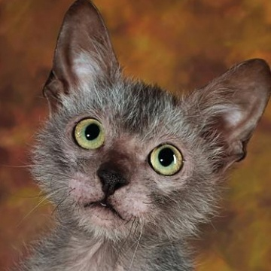
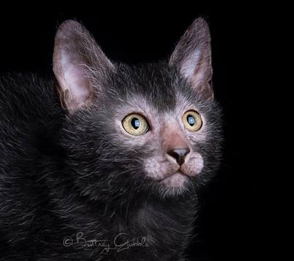
Eyes - 8 Points
Proper Eyes
Eyes are too large.
Medium, oval in shape to almost round. Hairless rims desirable.
Photos Credit: Brittney Gobble, Lykoicats.com

Slide 30
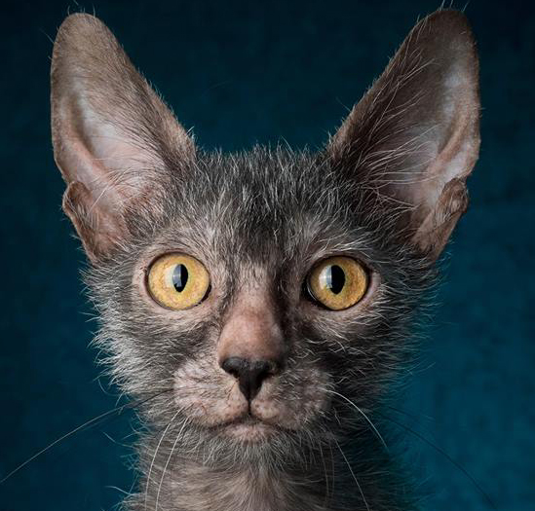
Ears - 8 Points
Proper Ears
Ears are far apart and point off to the side.
Large, wide at the base and pointed on the tips. Set high on the head, vertical and erect.
Photos Credit: Brittney Gobble, Lykoicats.com

Slide 31
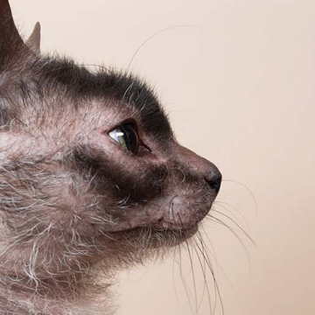
Profile - 2 Points
Proper Profile
A concave curve from brow to bridge. No stop.
Photo Credit: Brittney Gobble, Lykoicats.com

Slide 32
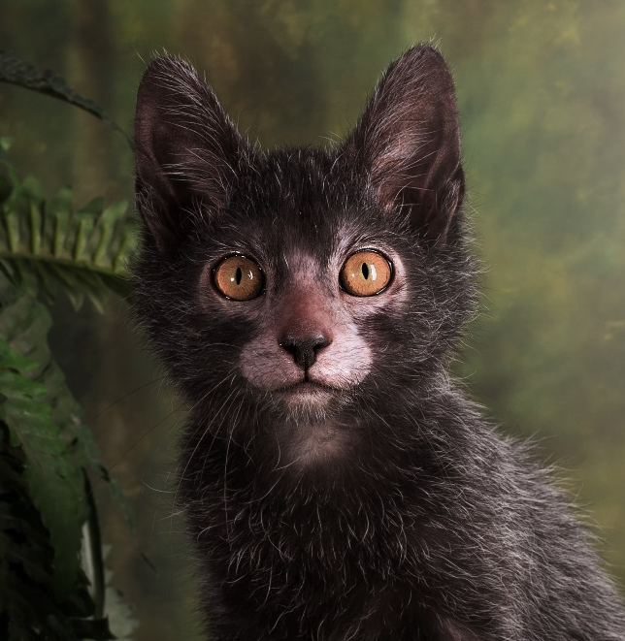
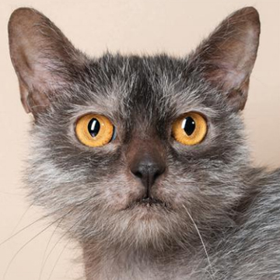
Mask - 12 Points
Hairless Mask
Lacks proper mask.
The face exhibits a hairless mask connecting the nose, muzzle, eyes and ears giving the classic werewolf appearance.
Photo Credit: Brittney Gobble, Lykoicats.com

Slide 33
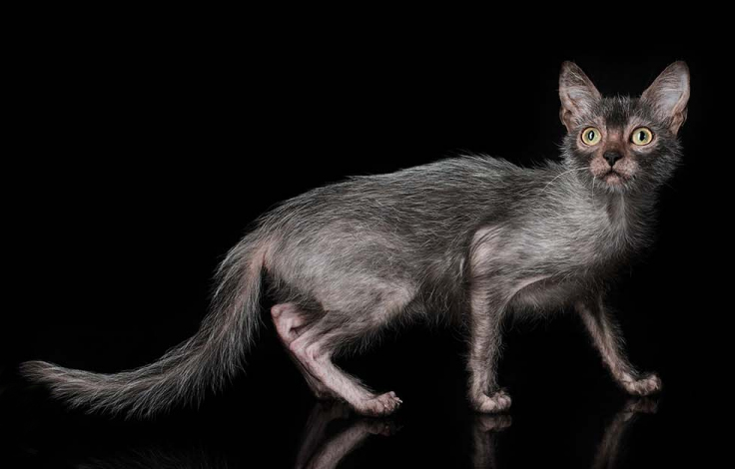
Body - 25 Points
Proper Structure, Musculature, Legs, Feet & Tail
Conformation strikes a medium between slightly slendered, semi-foreign and the elegance of the foreign body type. Proportion and larger balance allowed in males. Neck is medium length; either thin nor overly muscular. The coat is rough in appearance but soft and silky to the touch.
Photo Credit: Brittney Gobble, Lykoicats.com

Slide 34
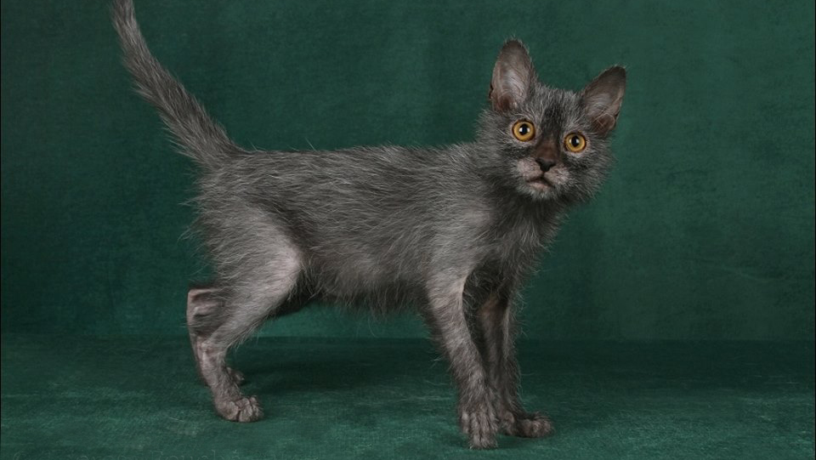
Breed Personality
Breed Research
Breed Personality
Photo Credit: Theresa Fouche

Slide 35
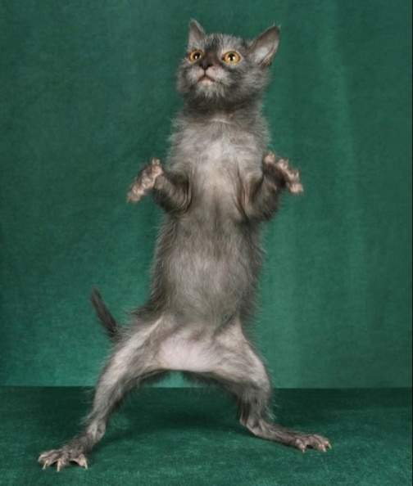
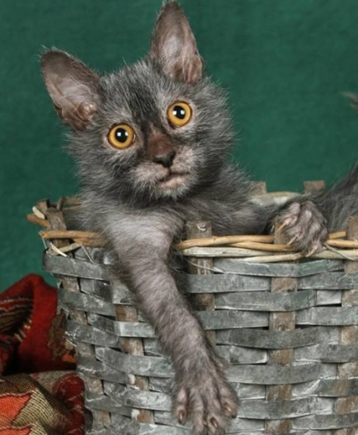
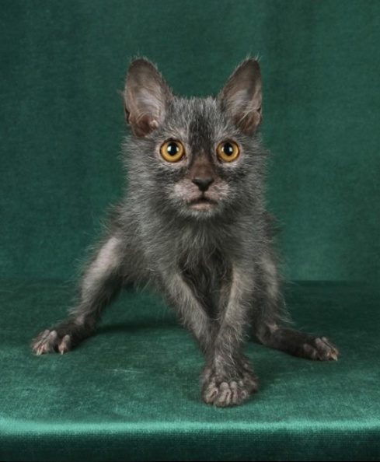
Breed Personality
Energetic
Very active and curious cat and enjoys interaction. Lykoi will stalk their toys, other pets, and even people. They raise up on their hind legs, posing there before they pounce. They, like many dogs, love playing chase and many will eagerly learn to fetch with their favorite human.
Affectionate
Very active and curious cat, prefers hunting over cuddling yet insists on attention. The Lykoi are very loyal and tend to bond well with people and other pets; especially other Lykoi. They are cautious at first and once they are assured that the new people or pets are safe, they will quickly warm up to them.
Inquisitive & Intelligent
Lykoi are first to scope out their environment. They make cautious observations then take control of their surroundings. They learn their name and will come when called. Because of their strong prey drive, intelligence, and protective nature, people say the werewolf look also defines their personality.
Photos Credit: Theresa Fouche

Slide 36
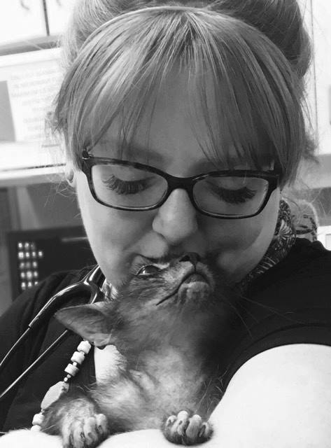
Breed Personality
Curiously Observant
"When I first met Quill, his shining eyes were what held my attention most. Like golden full moons. He was timid initially but not aggressive in any way and studied me closely as I chatted with his owner.
It only took a few minutes for his curious nature to get the best of him and he ventured closer to me. I was then quite shocked at how soft his sparse hair was. I had expected him to feel coarse and bristly but his hair was silky and lovely. He continued to take in his surroundings visually; preferring to stay close to his owner. This being unlike many cats who would be venturing around the room smelling and examining every inch.
Karma was the next Lykoi that I had the pleasure of meeting. In the hospital, she behaved very similar to Quill. Quiet, cautious and observant with the silkiest coat. However I then had the luxury of visiting her in her home. While she still had an underlying air of caution, she was eager to begin playing but on her own terms. Overall my first impression of the Lykoi is that they are wonderfully silky cats who are curiously observant, playful but mysterious, and prefer to do things on their own terms."
Dr. Kate Albrecht-Lupton, DVM
Photos Credit: Dr. Kate Albrecht-Lupton, DVM

Slide 37
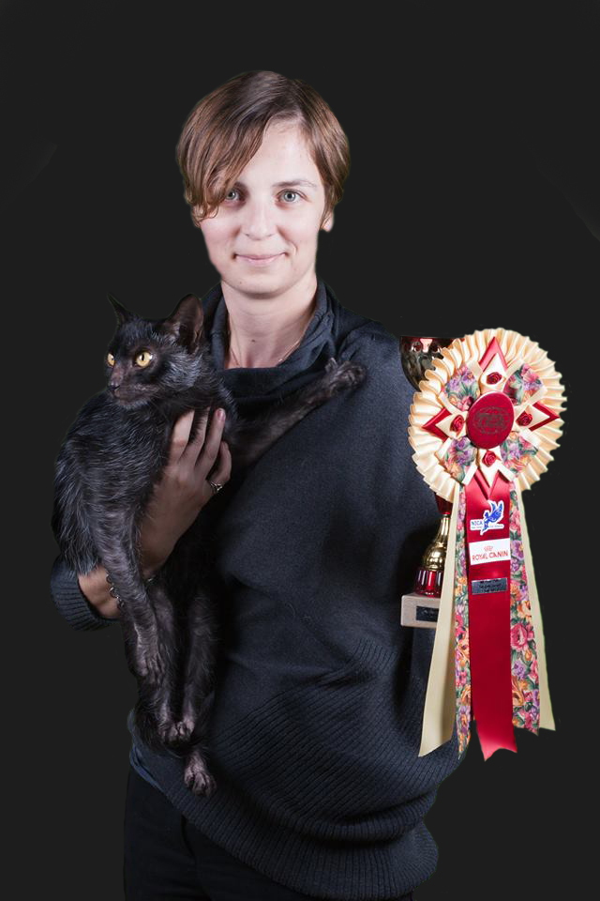

Registry Acceptance
Estimated Lykoi Breeders – 2017
In TICA: 40
In CFA: 13 (currently registered with CFA)
In Other (LOOF, ACF, WCF): 20
Estimated Lykoi
In TICA: 300+
In CFA: 64 (registered with approval)
In Other (LOOF, ACF, ACFA, WCF) : 125
Photo Credit: Anna Linden

Slide 38
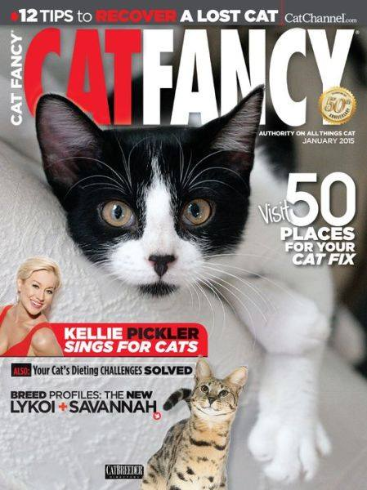
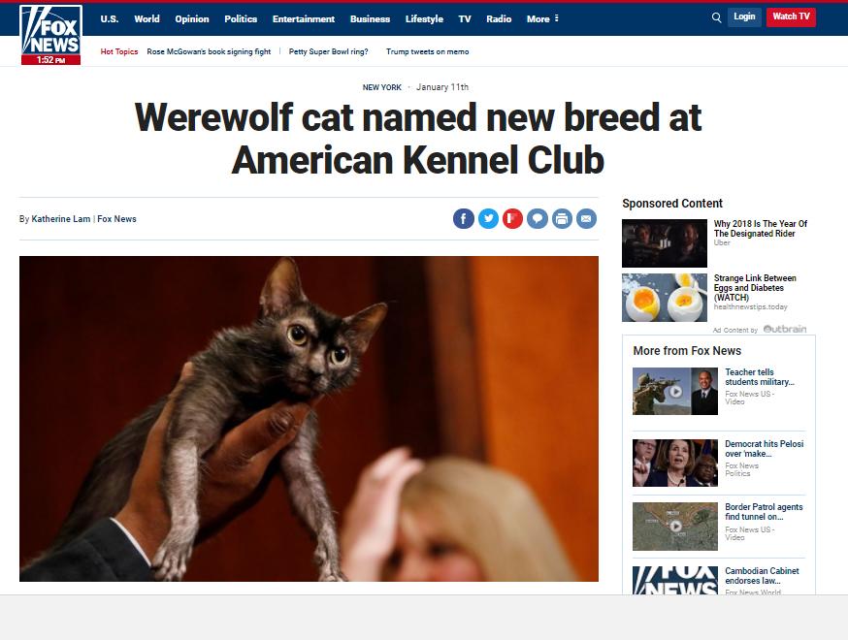
Lykoi In The Media

Slide 39
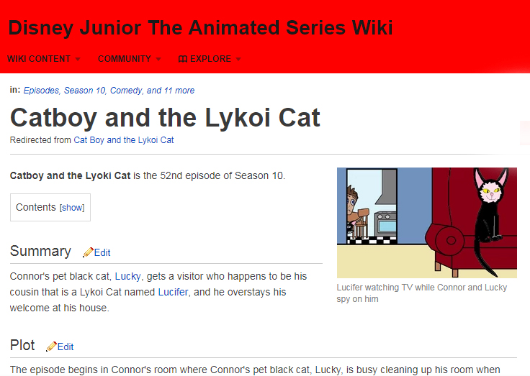
Lykoi In The Media

Slide 40


Lykoi In The Media

Slide 41

Lykoi In The Media

Slide 42

Lykoi In The Media

Slide 43

Lykoi In The Media

